Slide 1
Smart Intelligence Compliance Monitoring
Presented by
S.SRIRAM

Slide 2
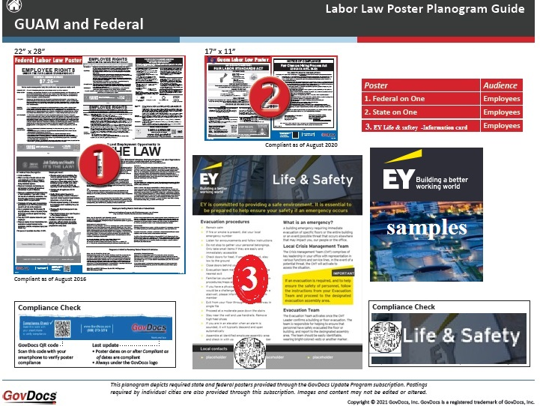

Slide 3
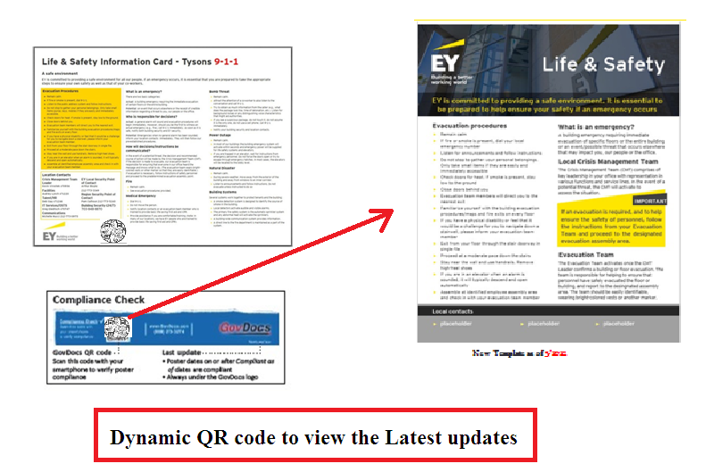

Slide 4
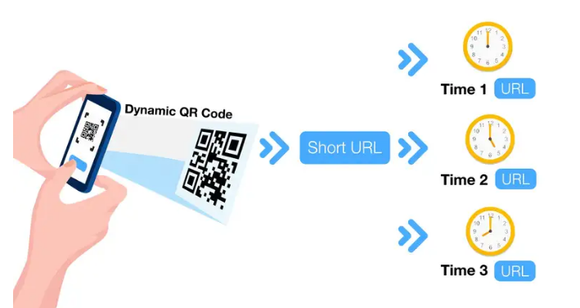
A QR code with multiple links or URL depending on the time you scan

Slide 5
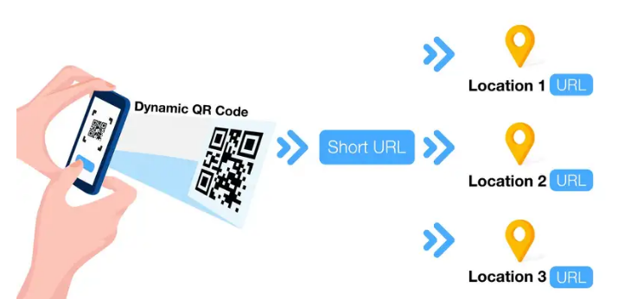
A Multi-URL QR Code

Slide 6


comparision
The user can drag the two select images for
Comparison whether the poster order arrangement is correct or not.

Slide 7
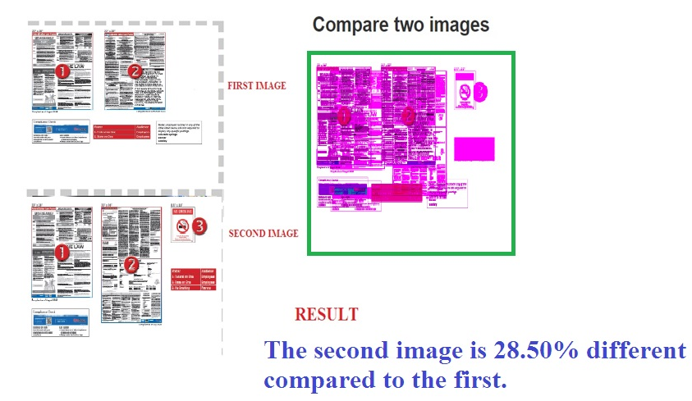

Slide 8
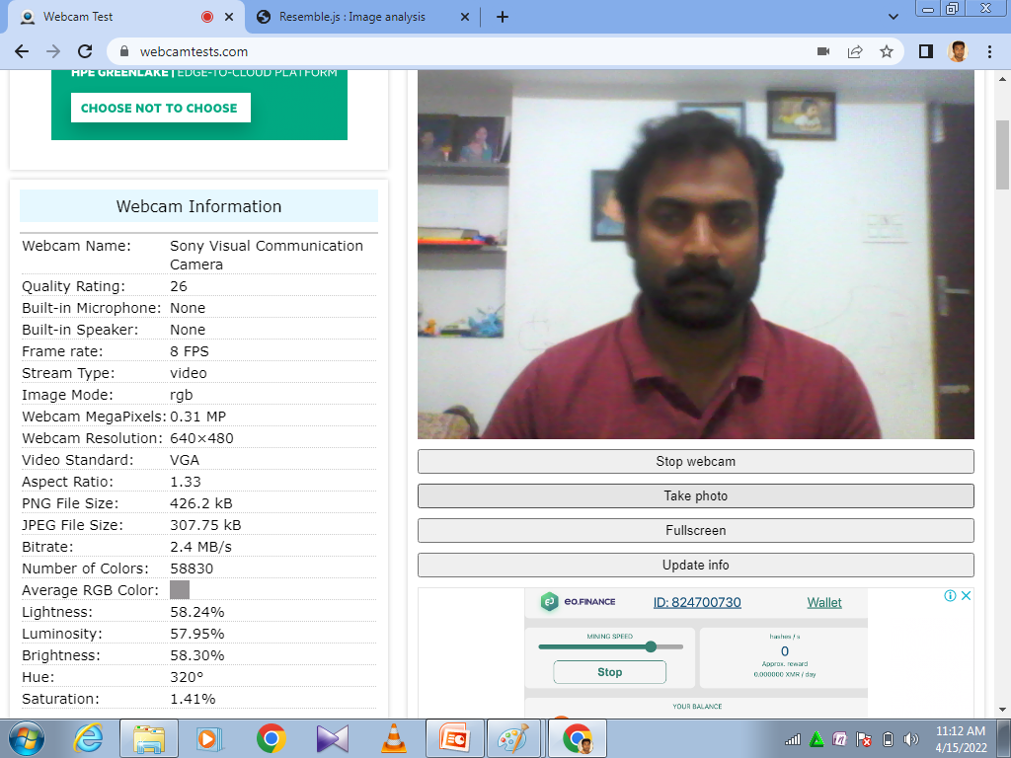
Sample web cam

Slide 9
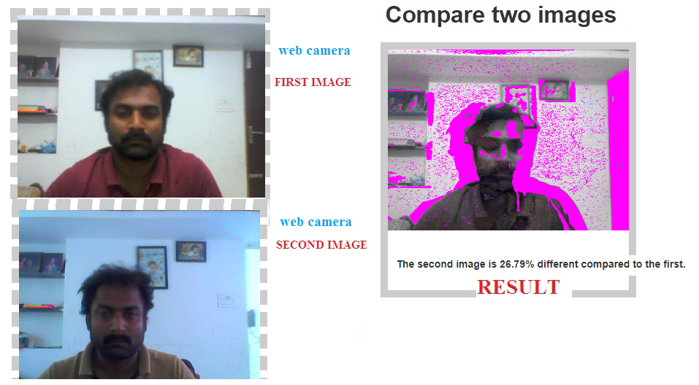
Web camera Test

Slide 10
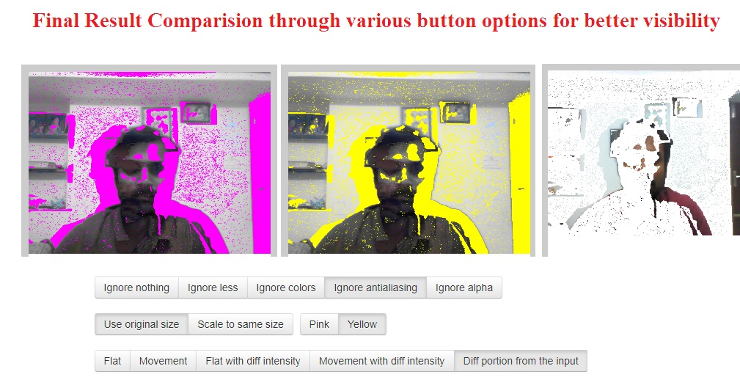
Web Camera Samples

Slide 11

Any Queries ?

